Slide 1
Machine Learning & Deep Learning
Instructor: Engr. Najam Aziz

Slide 2
What is AI, ML, DL?
Artificial Intelligence - the simulation of human intelligence in machines that are programmed to think like humans and mimic their actions.
Machine learning - a “field of study that gives computers the ability to learn without being explicitly programmed.”
Dynamic-Able to modify itself, does not need human intervention
Subset of AI. All ML counts as AI but not vice versa
Deep learning - a subset of machine learning. DL is reference to deep artificial neural networks.
Deep - refers to the number of layers in a neural network.
Notes:
SymbolicAI - the rules are created through human intervention, if-then statements-oop, For example, symbolic logic – rules engines, expert systems(emulate human intelligence for complex decision making) and knowledge graphs(DB contains data in graphical format) – could all be described as AI, and none of them are machine learning.
ML/DL- learns rules as it establishes correlations between inputs and outputs

Slide 3
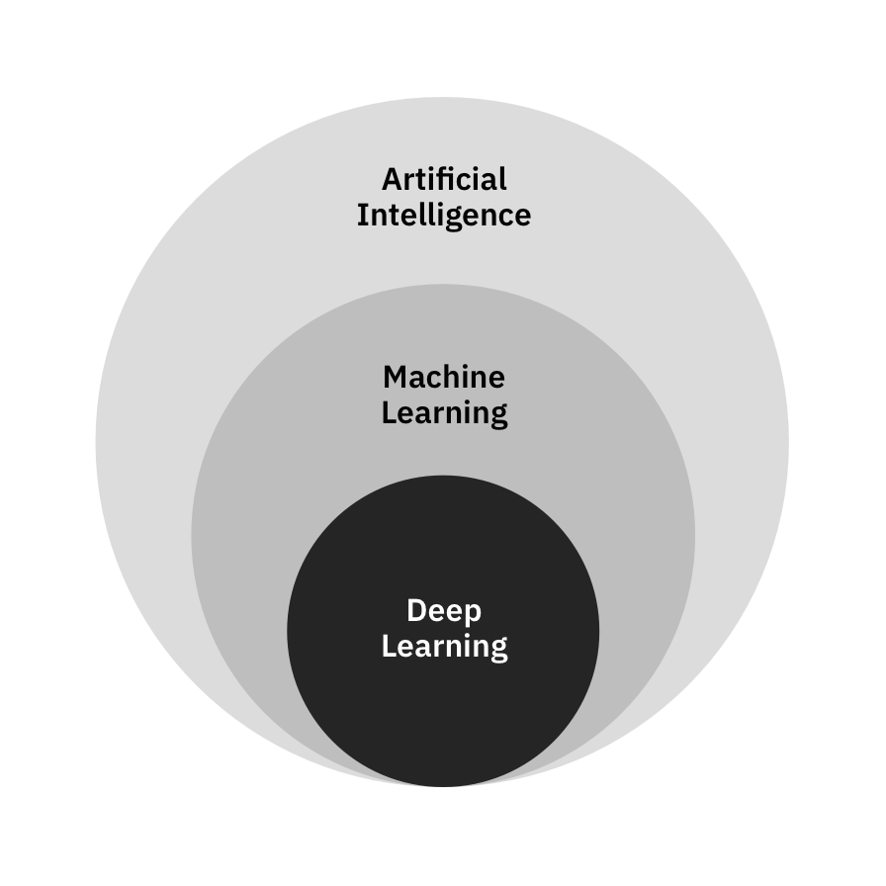
AI/ML/DL

Slide 4
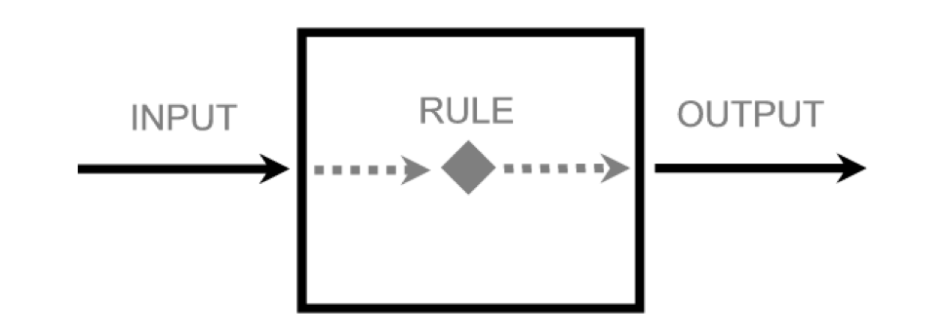
Aim/Goal
We have some input/data, want some output/desired. So, we need a Rule in between.

Slide 5
Data Science

Slide 6
What is Data?
Raw facts and Figures
Any unprocessed fact, value, text, sound or picture that is not being interpreted and analyzed.
Quantitative - Numerical
Discrete - Discrete data is a whole number (integer)
Continuous - have continuous values
Qualitative - Categorical
Non-numerical
Notes:
Quantitative: Discrete: # of people in a classroom Continous: Room Temperature. 37.5C or 37.5000001C
Qualitative: usually descriptive - brown eyes, male/female, yes/no

Slide 7
Data Type Conversion
Binning/Discretization: Transform Numerical variables to Categorical.
E.g. Age can be categorized into 0-12(Child), 13-19(Teenager), 20-65(Adult), 65+(Senior).
Binning is powerful and can be used as a filter to reduce noise or non-linearity and some algorithms such as decision trees require categorical data.
Encoding/Continuation: Transform Categorical variables into Numerical (Binary) variables.
E.g. Gender: -1 - Male, 0 - other, +1 - Female
Binary: Only 0 or 1

Slide 8
Data Exploration/Description
Summary/Descriptive statistics measurement meant to describe data.
For Numeric Variables
Mean, Median, Mode, max, min, range, quartiles/percentiles, variance, standard deviation, coefficient of determination, skewness, kurtosis
For Categorical Variables
The number of distinct counts.
Text: Frequency, inverse document frequency
Bivariate data: Linear correlation, chi-squared, the P-value based z-test, t-test, analysis of variance

Slide 9
Data Distribution - Basic Concepts of Statistics
Statistics - the discipline that concerns the collection, organization, analysis, interpretation, and presentation of data.
Variance - The average of the squared differences from the Mean.
Spread of a data set from its mean value
Magnitude of the spread
Covariance
Covariance tells us the direction in which two quantities vary with each other.
Salary has a positive covariance with respect to no. of hours worked-positive covariance
More practice-Less chance of losing
Correlation - used in feature selection to determine which feature affects the result the most.
Correlation shows us both, the direction and magnitude of how two quantities vary with each other.
Range; -1 to +1, Values between -1 and 1 denote the strength of the correlation.
Notes:
-Larger variance -the larger the distance, smaller variance - numbers in the set are closer to the mean.
You only know the magnitude here, as in how much the data is spread.

Slide 10
Understanding a Distribution
There are 3 variety of measures, required to understand a distribution:
Measure of Central tendency
Mean – or the average
Median – the value, which divides the population in two half
Mode – the most frequent value in a population
Measure of dispersion
Measures of dispersion reveal how the population is distributed around the measures of central tendency.
Range – Difference in the maximum and minimum value in the population
Quartiles – Values, which divide the population in 4 equal subsets (typically referred to as first quartile, second quartile and third quartile)
Variance: The average of the squared differences from the Mean.
Standard Deviation: is square root of variance
Measure to describe shape of curve
Skewness – Skewness is a measure of the asymmetry. Negatively skewed curve has a long left tail and vice versa.
Kurtosis – Kurtosis is a measure of the “peakedness”. Distributions with higher peaks have positive kurtosis and vice-versa
Notes:
Measures of central tendencies are measures, which help you describe a population, through a single metric. For example, if you were to compare the savings habits of people across various nations, you will compare the average Savings rate in each of these nations.
Understanding the shape of data is a crucial action. It helps to understand where the most information is lying and analyze the outliers in a given data

Slide 11
Model/Algorithm Engineering

Slide 12
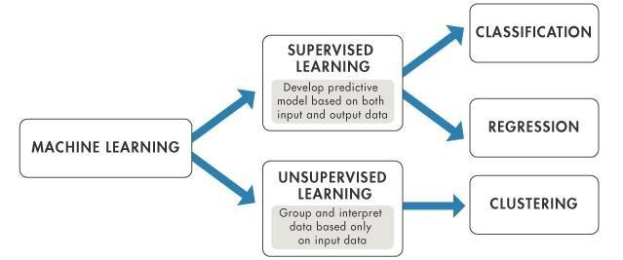
ML Problem-Model Division

Slide 13
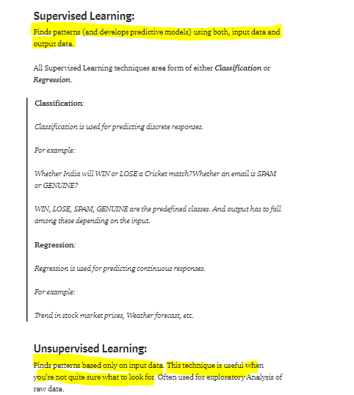

Slide 14
Supervised vs Unsupervised Learning
Supervised
labeled input and output data
Examples: Linear Regression, Logistic Regression, Support Vector Machine, KNN etc.
Unsupervised
work on their own to discover the inherent structure of unlabeled data
not used as widely as supervised learning.
Examples: clustering, K-mean clustering etc
Main Difference: the use of labeled data

Slide 15
Types of Supervised Learning
Regression algorithms are used to predict the continuous values such as price, salary, age, etc.
Dependent variable is continuous in nature
finding annual sale of a company
Classification algorithms are used to predict/Classify the discrete values such as Male or Female, True or False, Spam or Not Spam, etc.
Dependent variable is discrete/categorical in nature
Example: Divide the class in age group

Slide 16
Which of the Following are Regression or Classification Task?
What is the nationality of a person?
What is the age of a person?
Predicting whether stock price of a company will increase tomorrow
Predict whether a customer is eligible for a loan
Price of Car
Predict if Covid patient Survive?
How much gas will I spend if I drive for 100 miles?
Which is the closest planet to the Sun?
Predicting nationality is categorical and the closest planet to the Sun is discrete.
Notes:
Predicting age of a person (because it is a real value,
predicting nationality is categorical,
whether stock price will increase is discrete-yes/no answer

Slide 17
Regression

Slide 18
Types of Regression
Univariate Linear Regression
variables: independent =1 and dependent =1
Relationship Nature: Linear
Multiple Regression
variables: independent >1 and dependent =1
Relationship Nature: Linear/Non Linear
Multivariate Regression
variables: independent >1 and dependent >1
Relationship Nature: Linear/Non-Linear
Polynomial Regression
the power of the independent variable is more than 1.
Relationship Nature: Non-Linear
Y = a + bX^2
The best fit line is not a straight line, rather a curve that fits into the data points.

Slide 19
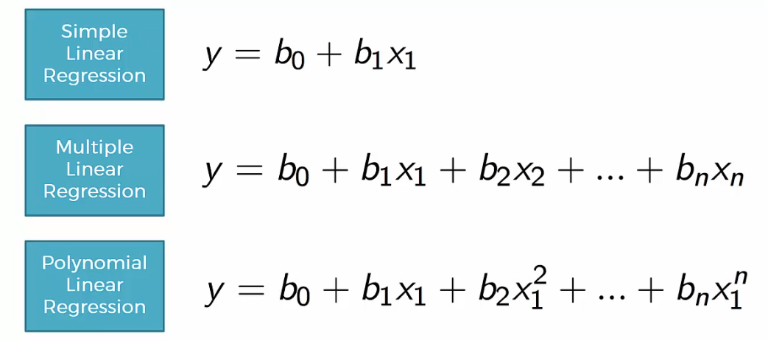
Regression
Notes:
Incase of multiple lines, Best fit line wo hogi jisme error sabse kam hoga.

Slide 20
Linear and Logistic Regression
Linear regression is used to predict the continuous dependent variable using a given set of independent variables.
Logistic regression is usually used with binary response variables ( 0 or 1 ), the predictors can be continuous or discrete.
Used for Classification problem
example: Time spend on website and click on ads

Slide 21
Linear Regression
https://www.knowledgehut.com/blog/data-science/what-is-machine-learning Machine learning various topics
https://www.guru99.com/linear-regression-tensorflow.html
Linear Regression Tutorial with TensorFlow [Examples]

Slide 22

A regression problem is when the resulting variable contains a real or a continuous value. It tries to draw the line of best fit from the data gathered from a number of points.
What is Linear Regression?
Linear Regression is one of the machine learning algorithms where the result is predicted by the use of known parameters which are correlated with the output. It is used to predict values within a continuous range rather than trying to classify them into categories. The known parameters are used to make a continuous and constant slope which is used to predict the unknown or the result.
Let’s say we have a dataset which contains information about the relationship between ‘number of hours studied’ and ‘marks obtained’. A number of students have been observed and their hours of study along with their grades are recorded. This will be our training data. Our goal is to design a model that can predict the marks if number of hours studied is provided. Using the training data, a regression line is obtained which will give minimum error. This linear equation is then used to apply for a new data. That is, if we give the number of hours studied by a student as an input, our model should be able to predict their mark with minimum error.

Slide 23
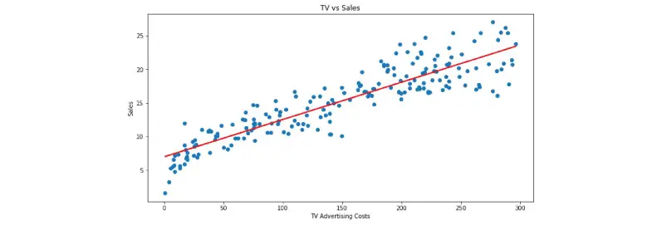
How does Linear Regression work?
Let’s look at a scenario where linear regression might be useful: losing weight. Let us consider that there’s a connection between how many calories you take in and how much you weigh; regression analysis can help you understand that connection. Regression analysis will provide you with a relation which can be visualized into a graph in order to make predictions about your data. For example, if you’ve been putting on weight over the last few years, it can predict how much you’ll weigh in the next ten years if you continue to consume the same amount of calories and burn them at the same rate.
The goal of regression analysis is to create a trend line based on the data you have gathered. This then allows you to determine whether other factors apart from the amount of calories consumed affect your weight, such as the number of hours you sleep, work pressure, level of stress, type of exercises you do etc. Before taking into account, we need to look at these factors and attributes and determine whether there is a correlation between them. Linear Regression can then be used to draw a trend line which can then be used to confirm or deny the relationship between attributes. If the test is done over a long time duration, extensive data can be collected and the result can be evaluated more accurately. By the end of this article we will build a model which looks like the below picture i.e, determine a line which best fits the data.

Slide 24

How do we determine the best fit line?
The best fit line is considered to be the line for which the error between the predicted values and the observed values is minimum. It is also called the regression line and the errors are also known as residuals. The figure shown below shows the residuals. It can be visualized by the vertical lines from the observed data value to the regression line.
When to use Linear Regression?
Linear Regression’s power lies in its simplicity, which means that it can be used to solve problems across various fields. At first, the data collected from the observations need to be collected and plotted along a line. If the difference between the predicted value and the result is almost the same, we can use linear regression for the problem.

Slide 25
Assumptions in linear regression
If you are planning to use linear regression for your problem then there are some assumptions you need to consider:
The relation between the dependent and independent variables should be almost linear.
The data is homoscedastic, meaning the variance between the results should not be too much.
The results obtained from an observation should not be influenced by the results obtained from the previous observation.
The residuals should be normally distributed. This assumption means that the probability density function of the residual values is normally distributed at each independent value.
You can determine whether your data meets these conditions by plotting it and then doing a bit of digging into its structure.
Few properties of Regression Line
Here are a few features a regression line has:
Regression passes through the mean of independent variable (x) as well as mean of the dependent variable (y).
Regression line minimizes the sum of “Square of Residuals”. That’s why the method of Linear Regression is known as “Ordinary Least Square (OLS)”. We will discuss more in detail about Ordinary Least Square later on.
B1 explains the change in Y with a change in x by one unit. In other words, if we increase the value of ‘x’ it will result in a change in value of Y.

Slide 26
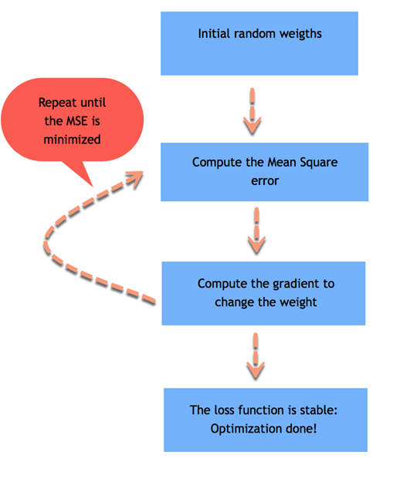
How Linear Regression work

Slide 27
Logistic Regression

Slide 28
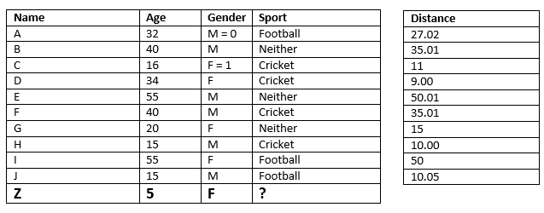
Example-01. Classification
If K = 3, K = 5
Notes:
Classification: Final decision - Mode
Regress: Final Decsion - Mean or Average of the K nearest neighbors

Slide 29
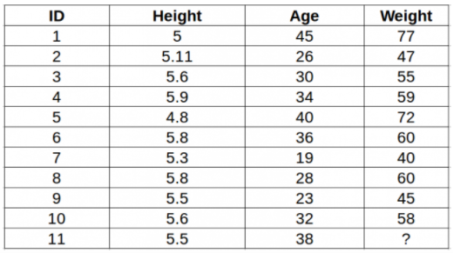
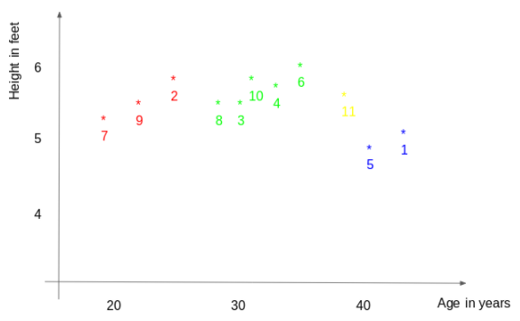
Example-02. Regression

Slide 30
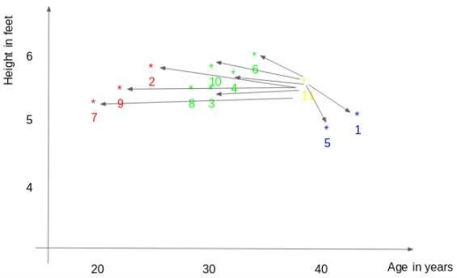
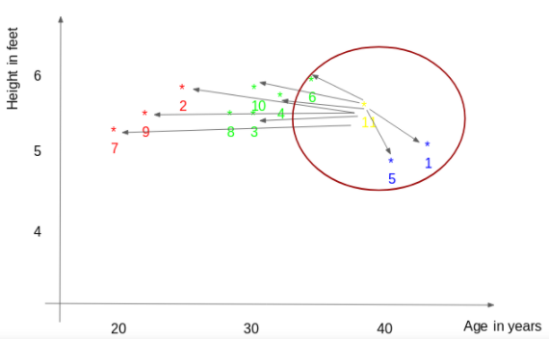
Example02 -Regression
Notes:
Regress: Final Decsion - Mean or Average of the K nearest neighbors = (77(ID1)+72(ID5)+60(ID6))/3 = 69.66 kg.

Slide 31


Slide 32
Data science engineers and developers working in various domains are widely using machine learning algorithms to make their tasks simpler and life easier. For example, certain machine learning algorithms enable Google Maps to find the fastest route to our destinations, allow Tesla to make driverless cars, help Amazon to generate almost 35% of their annual income, AccuWeather to get the weather forecast of 3.5 million locations weeks in advance, Facebook to automatically detect faces and suggest tags and so on

